Slide 1
All Takeout Reviews
Ryo Sushi
Happy Camper

Slide 2
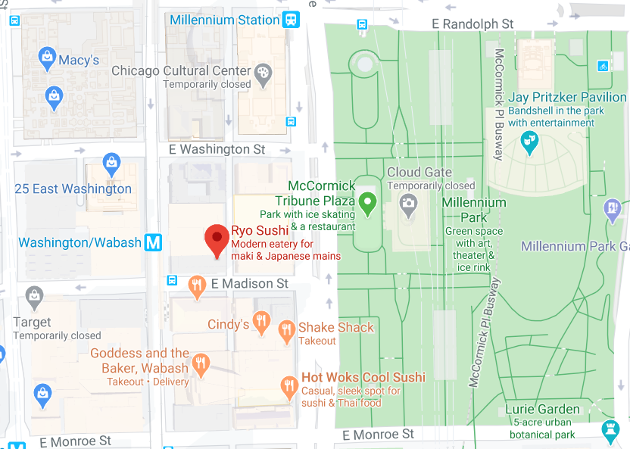
Ryo Sushi
<Content>
Comments
User 1
<Comment>
User 2
<Comment>

Slide 3
Leave a Comment on Ryo Sushi
Your Name
Your Comment
Submit

Slide 4
Register
Your Name
E-Mail Address
Password
Submit

Slide 5
Login
E-Mail Address
Password
Submit

Slide 6
User Stories
As a reader, I would want to see a list of takeout restaurants.
As a reader, I would want to see the details of a takeout restaurant (description, phone number, etc.)
As a reader, I would want to see the location of the restaurant on a map.
As a reader, I would want to be able to comment on my experience if I were to order from the restaurant myself.
As a reader, I would want to see the name and comments of other readers.
As a reader, I would want to be able to create an account.

Slide 7
Domain Model
restaurants
id (primary key)
title (string)
description (string, text)
phone (string)
location (string)
posts
id (primary key)
restaurant_id (foreign key)
user_id (foreign key)
like (boolean)
comments (string, text)
users
id (primary key)
name (string)
email (string)
password (string)

